Slide 1
National Service Scheme Unit
Govt. Degree College Banjar
Welcomes
you
(Session: 2022-23)

Slide 2
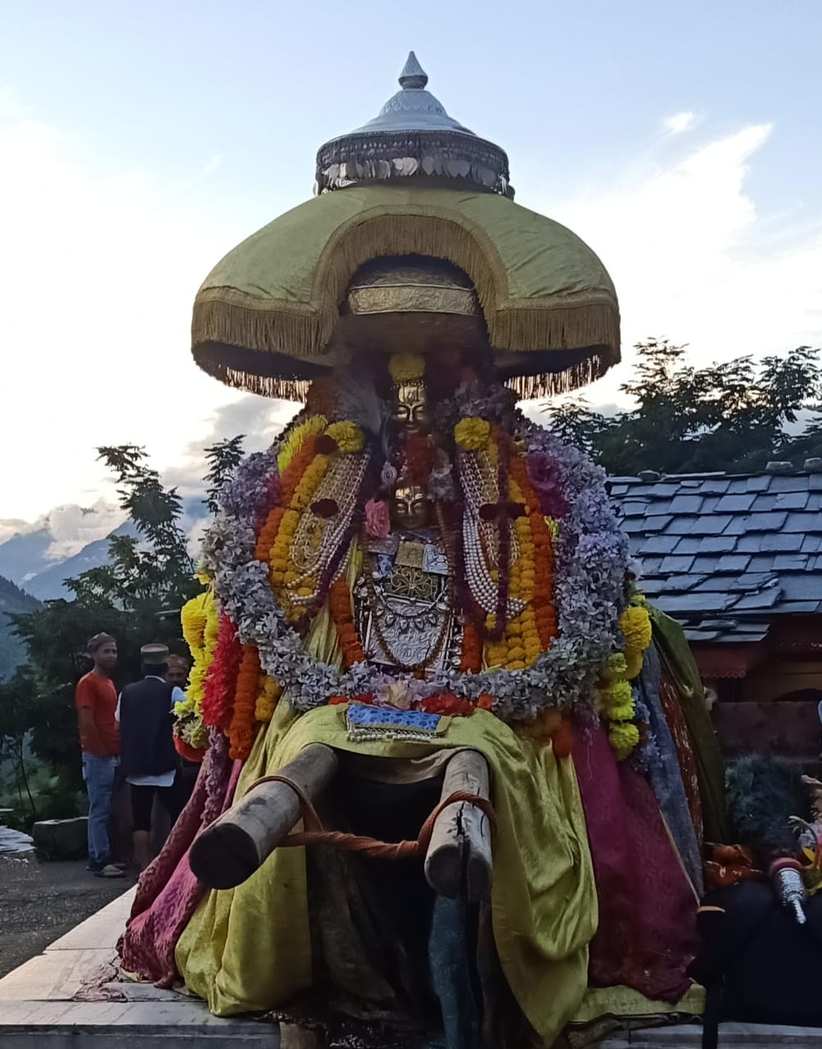

Slide 4
Regular Activities of NSS Unit:
(I) Enrollment Drive for NSS Volunteers:

Slide 5
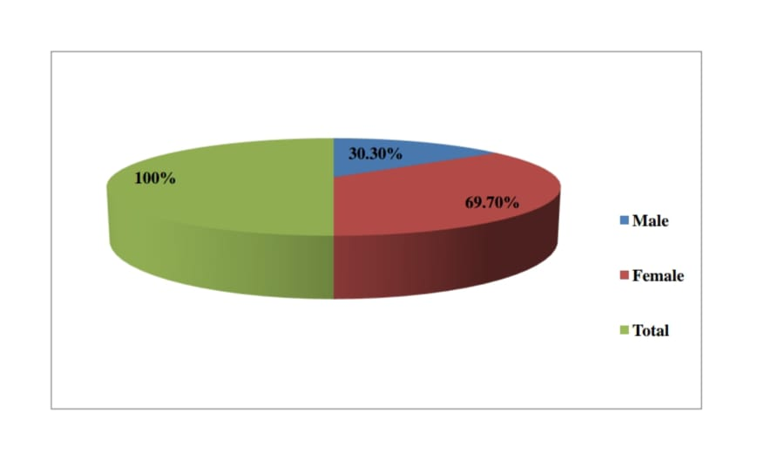

Slide 6
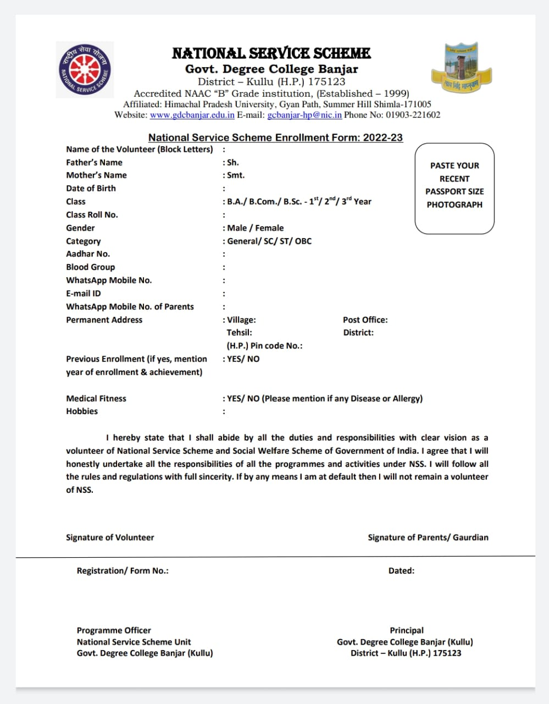

Slide 7
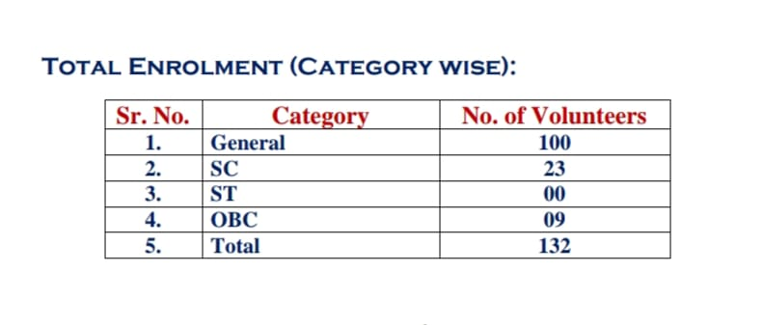

Slide 8
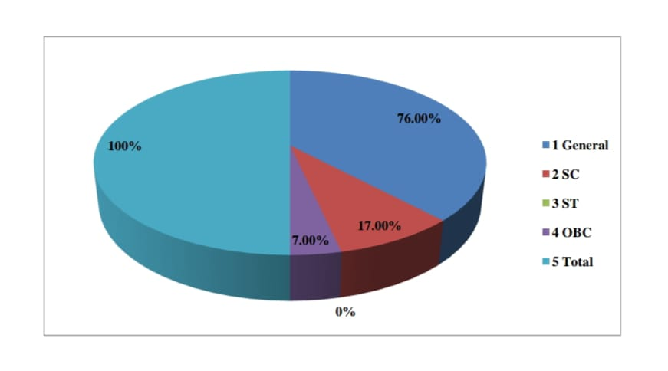

Slide 9
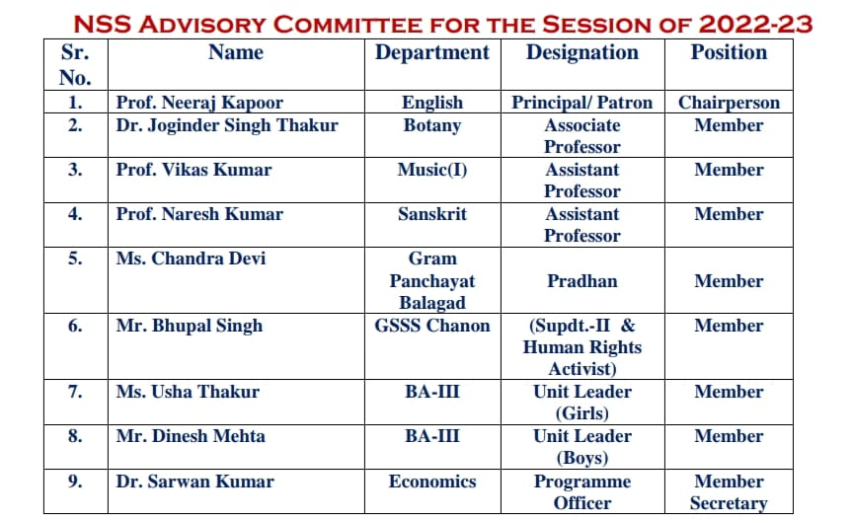
(II) Formation of NSS Advisory Committee:

Slide 10
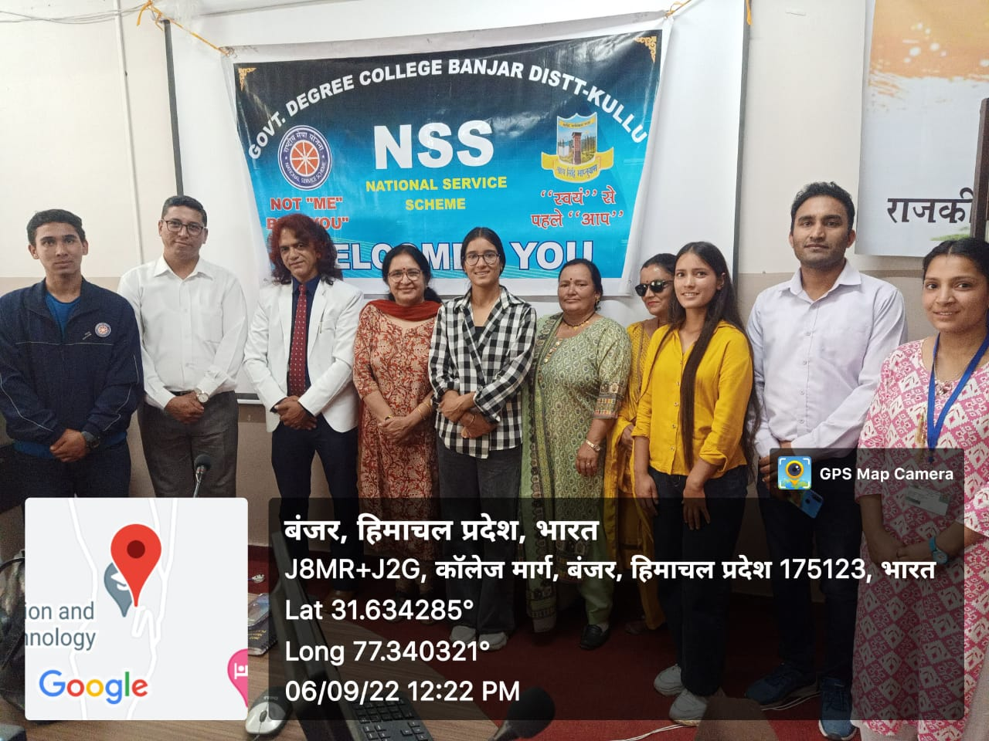
NSS Advisory Committee Members with Principal Prof. Neeraj Kapoor

Slide 11
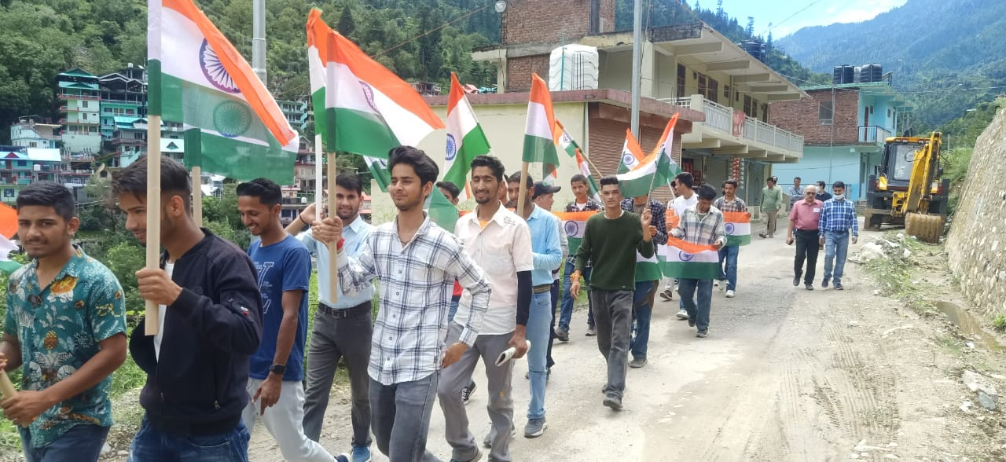
(III) Har Ghar Tiranga Campaign by NSS unit:

Slide 12
ßgj Äj frjaxk dk;ZØeÞ
NSS Unit Govt. Utkrisht Mahavidyalaya Banjar (Kullu)
organize
Special Programme Series from 08th to 15th August, 2022

Slide 13
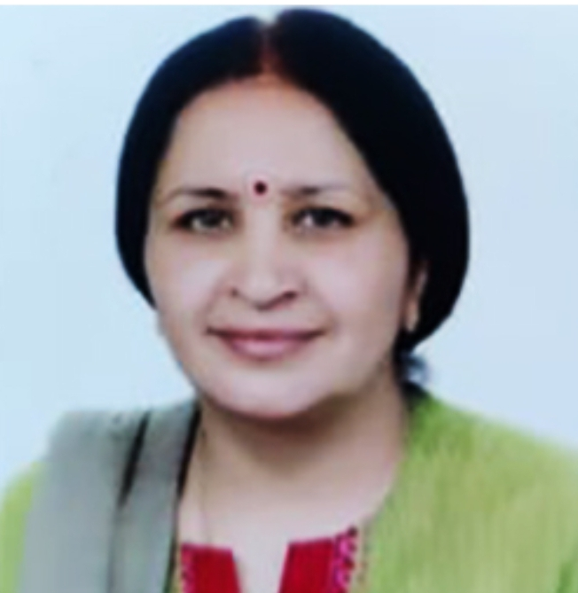
NATIONAL Service scheme
Govt. Utkrisht Mahavidyalaya Banjar
District – Kullu (H.P.) 175123
Accredited NAAC “B” Grade institution, (Established – 1999)
E-mail: gcbanjar-hp@nic.in Phone No: 01903-221602
Website: www.gdcbanjar.edu.in
Organize
A Special Lecture
on the topic of
“fo'o xq: Òkjr”
Monday 08th August, 2022 (11:30 A.M. - 12:30 P.M.)
at
College Conference Room
By
Dr. Duni Chand Rana
Assistant Professor (Political Science)
Chief Guest
Prof. Neeraj Kapoor
(Principal & Patron)

Slide 14
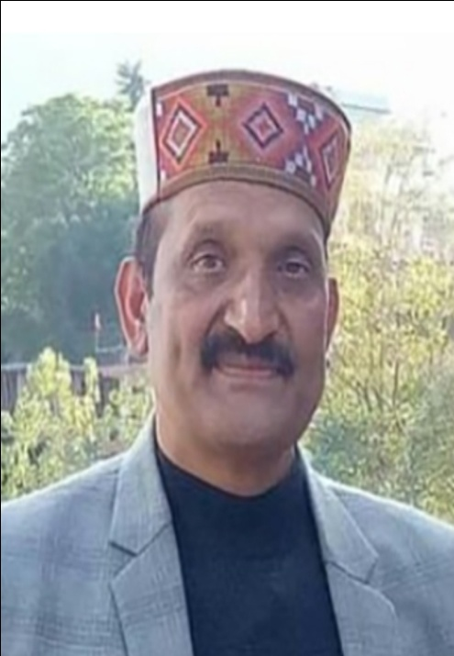
NATIONAL Service scheme
Govt. Utkrisht Mahavidyalaya Banjar
District – Kullu (H.P.) 175123
Accredited NAAC “B” Grade institution, (Established – 1999)
E-mail: gcbanjar-hp@nic.in Phone No: 01903-221602
Website: www.gdcbanjar.edu.in
Organize
Various Activities
on the theme of
“India’s Rich Cultural Heritage”
Wednesday 10th August, 2022 (11:00 A.M. - 01:30 P.M.)
at
College Conference Room
By
Volunteers of NSS College Unit
Chief Guest
Dr. Joginder Thakur
(Associate Professor Botany)

Slide 15
Prabhat Pheri
Quiz
Rally and Nukkad Natak
Debate
Declamation
Essay Writing
Slogan Writing
Poster Making
Types of Activities:

Slide 16
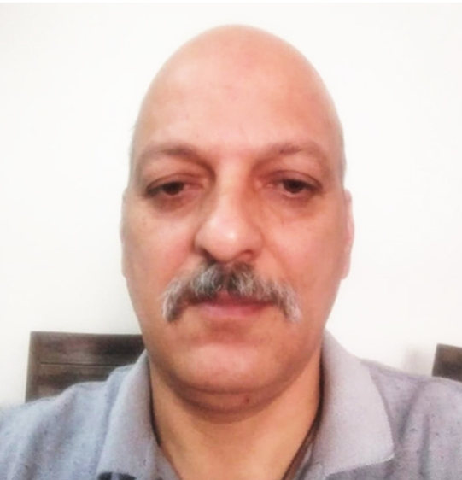
NATIONAL Service scheme
Govt. Utkrisht Mahavidyalaya Banjar
District – Kullu (H.P.) 175123
Accredited NAAC “B” Grade institution, (Established – 1999)
E-mail: gcbanjar-hp@nic.in Phone No: 01903-221602
Website: www.gdcbanjar.edu.in
Organize
Social Awareness Rally & Special Lecture
on
“Celebrating Unsung Heroes”
Friday 12th August, 2022 (11:30 A.M. - 12:30 P.M.)
at
College Conference Room
By
Prof. Ishan Marvel
Assistant Professor (English)
Chief Guest
Dr. Ramesh Yadav
(Associate Professor Zoology)

Slide 17
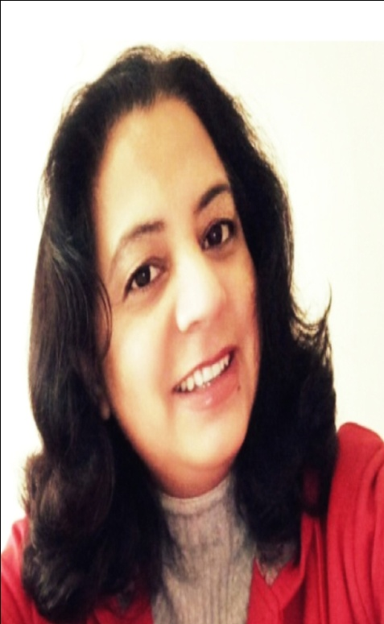
NATIONAL Service scheme
Govt. Utkrisht Mahavidyalaya Banjar
District – Kullu (H.P.) 175123
Accredited NAAC “B” Grade institution, (Established – 1999)
E-mail: gcbanjar-hp@nic.in Phone No: 01903-221602
Website: www.gdcbanjar.edu.in
Organize
One Minute Video Show Competition
on the theme of
“Independence 2.0”
Saturday 13th August, 2022 (11:00 A.M. - 12:30 P.M.)
at
College Conference Room
By
NSS Volunteers of College Unit
Chief Guest
Dr. Renuka Thapliyal
(Associate Professor Geography)

Slide 18
NATIONAL Service scheme
Govt. Utkrisht Mahavidyalaya Banjar
District – Kullu (H.P.) 175123
Accredited NAAC “B” Grade institution, (Established – 1999)
E-mail: gcbanjar-hp@nic.in Phone No: 01903-221602
Website: www.gdcbanjar.edu.in
Independence Day Celebration
in the College Campus
On
15th August, 2022
(Monday) 09:30 A.M. Onwards
Chief Guest
Prof. Neeraj Kapoor
(Principal & Patron)

Slide 19
gj Äj frjaxk lansÓ gSA
Át+knh dk ve`r eg¨Ùlo foÓsÔ gSAA

Slide 20
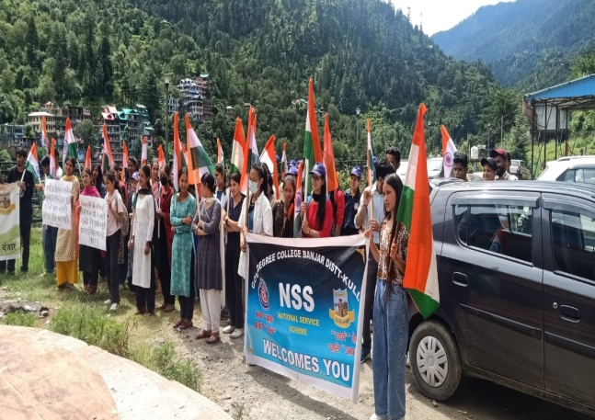

Slide 21
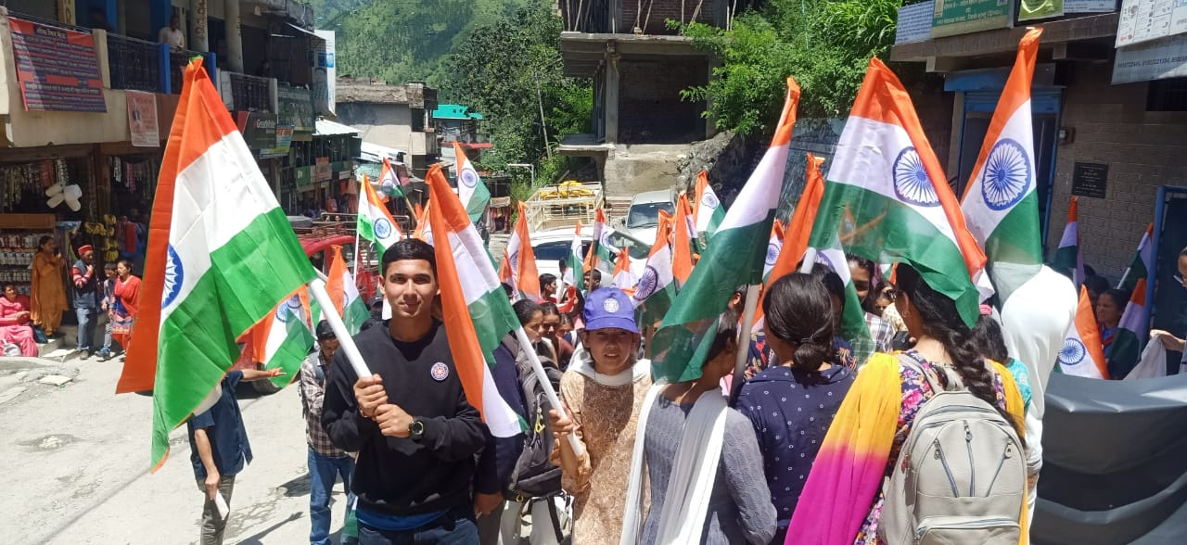

Slide 22
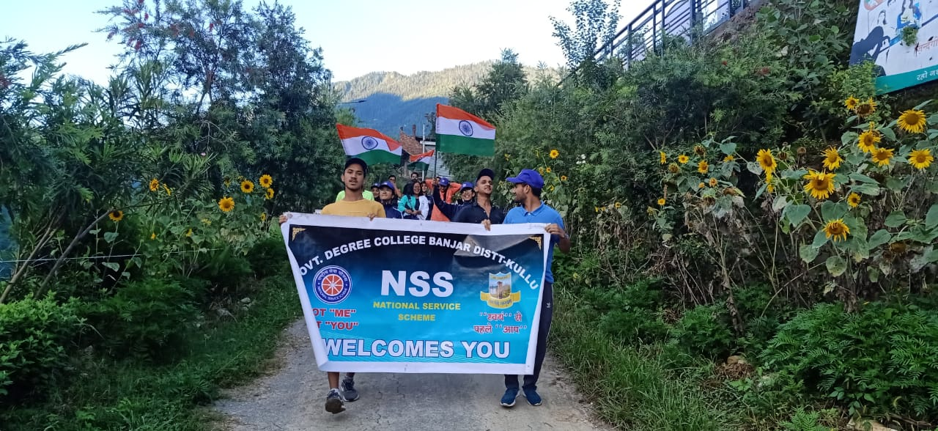
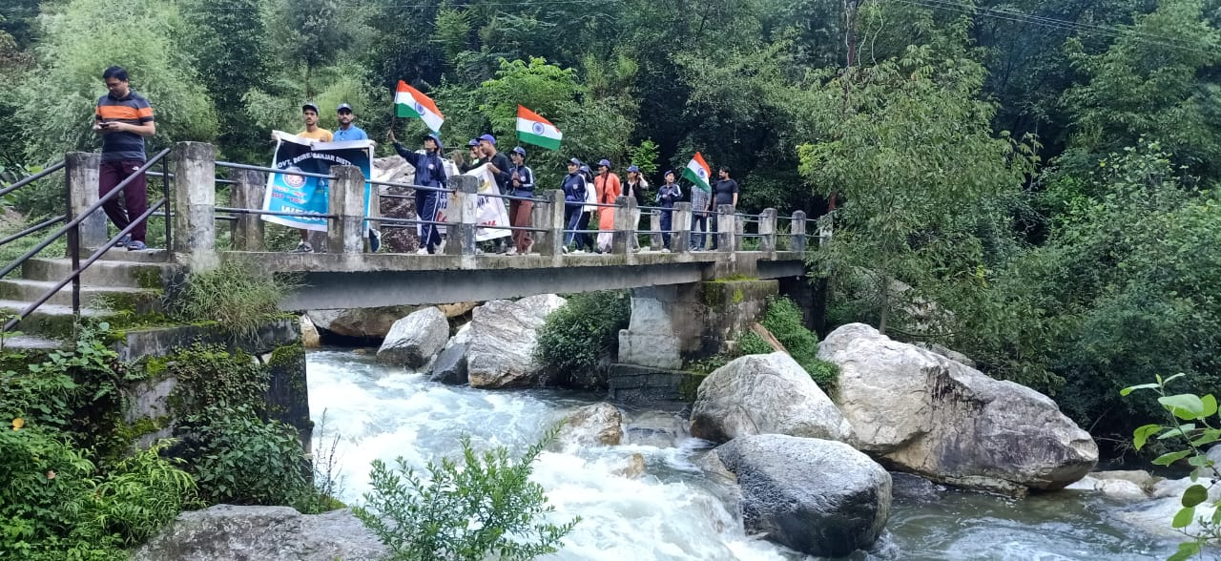

Slide 23
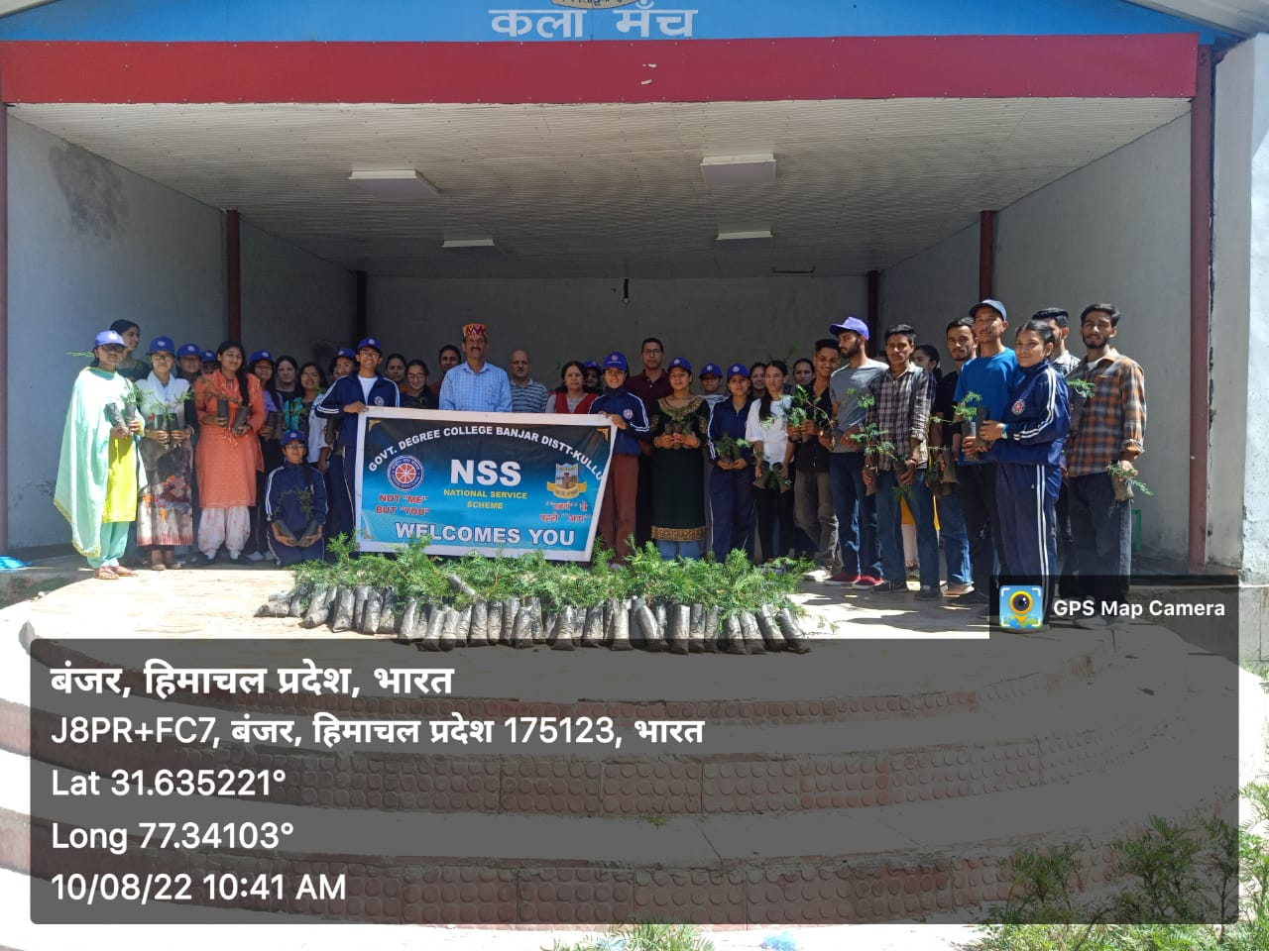
(IV) Plantation drive in Campus by NSS unit:

Slide 24
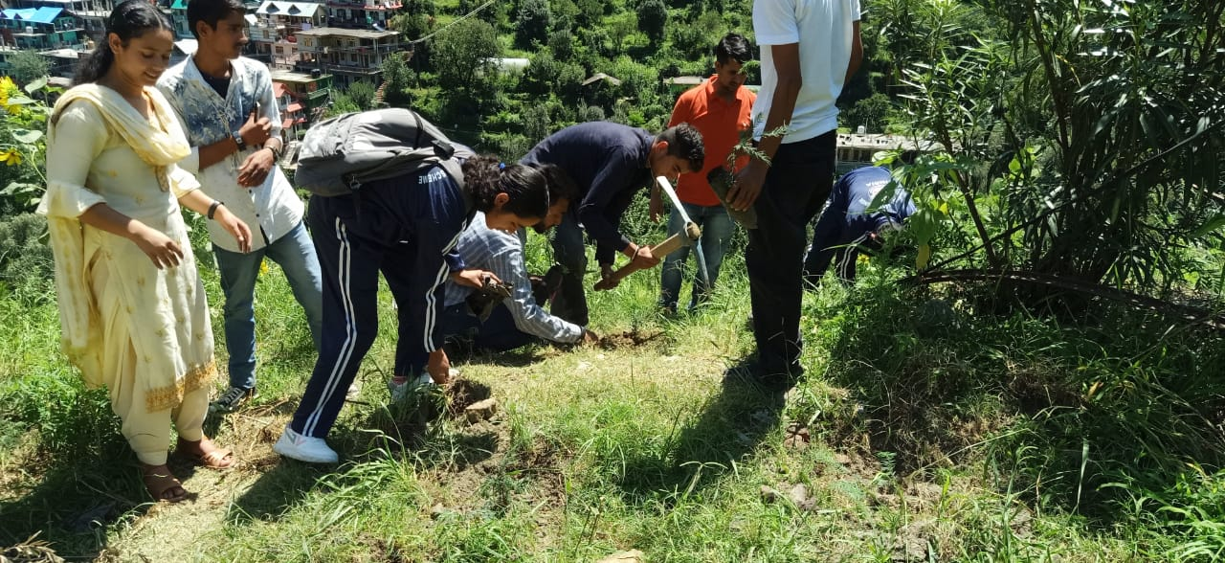

Slide 25
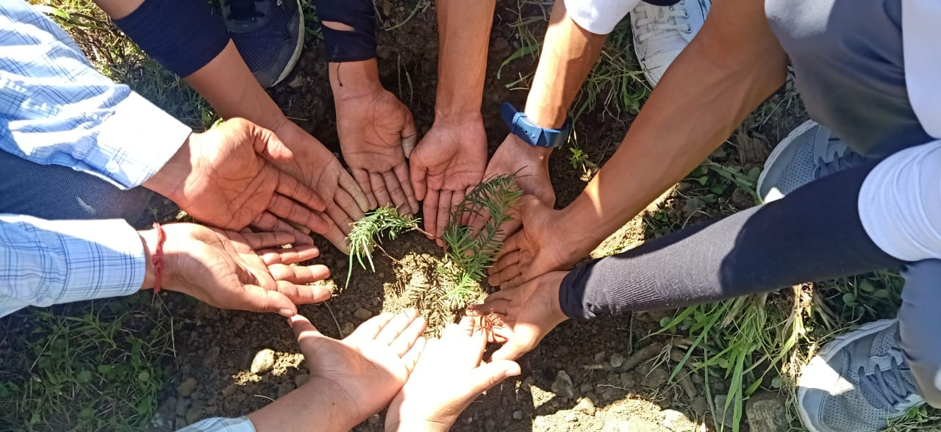

Slide 26
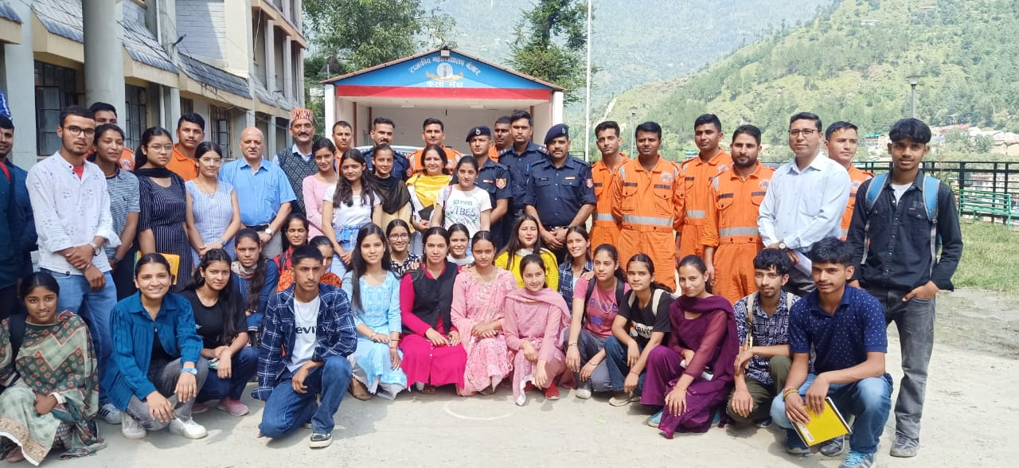
(V) NDRF Mock drill in Campus:

Slide 27
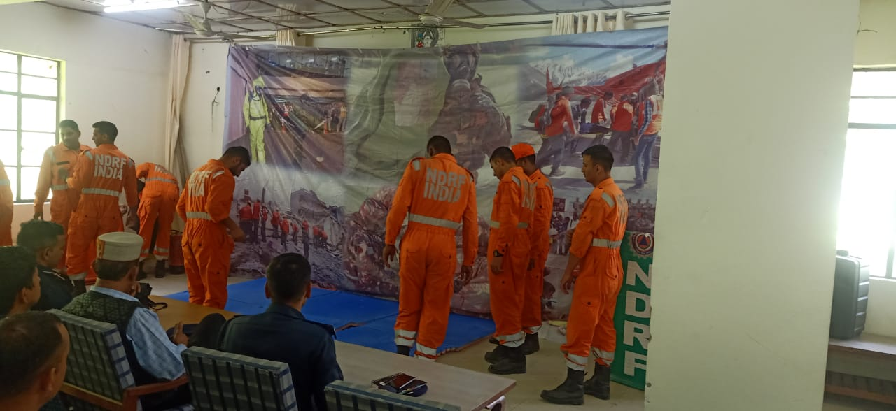

Slide 28
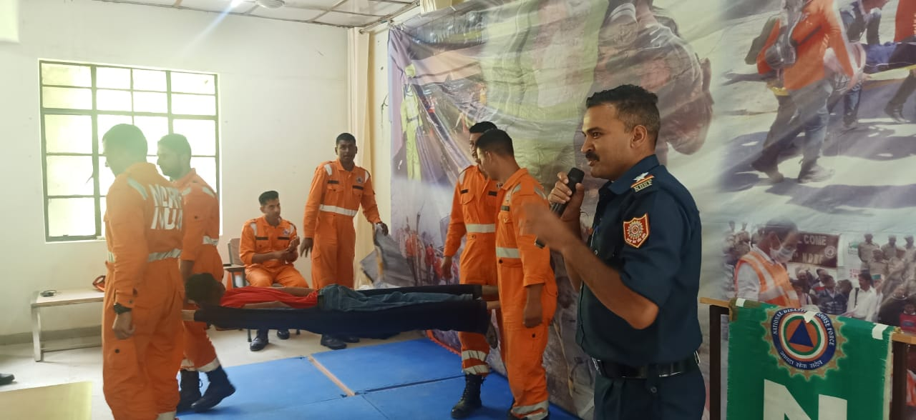

Slide 29
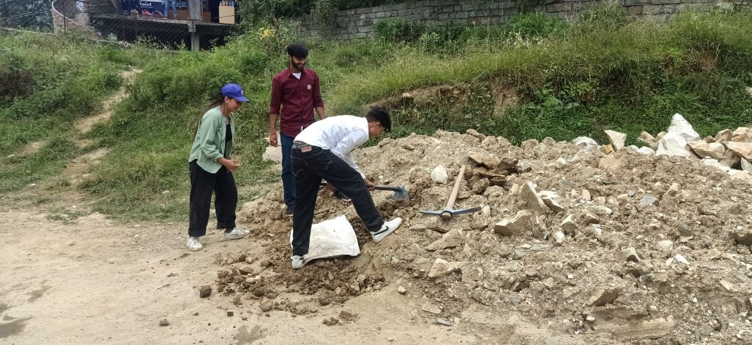
(VI) Campus Beautification Drive by NSS unit :

Slide 30
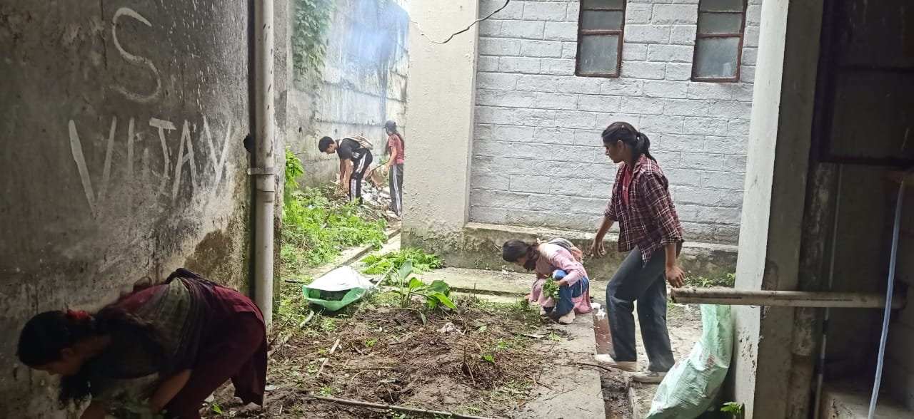

Slide 31
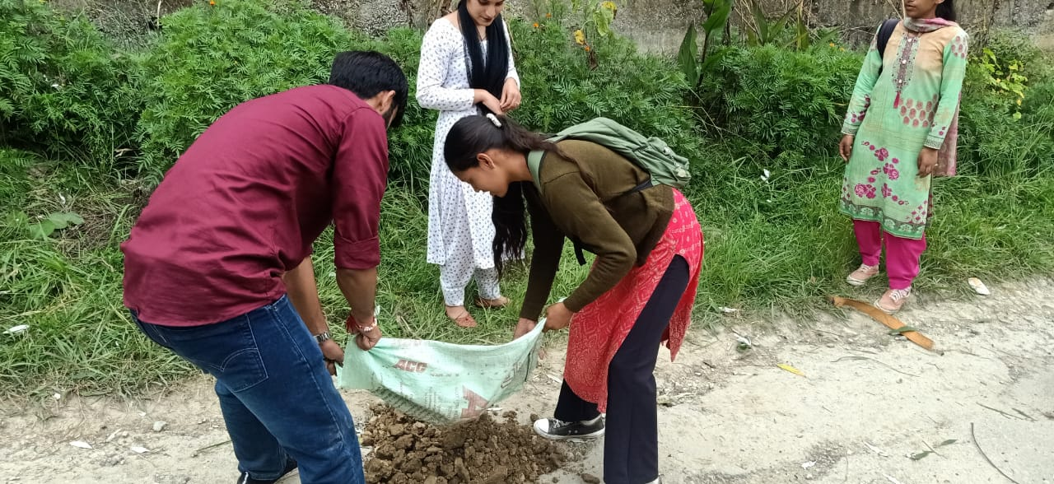

Slide 32
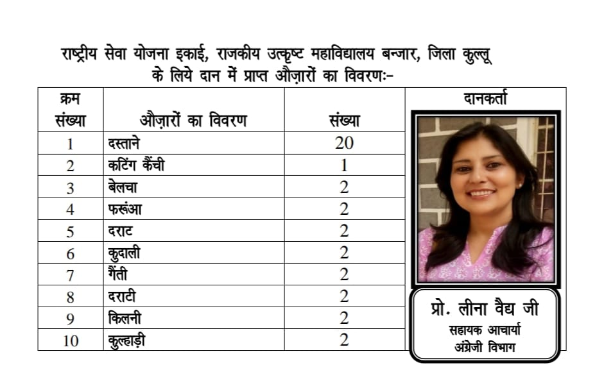
(VII) Tools/ Equipments Donation for NSS unit :

Slide 33
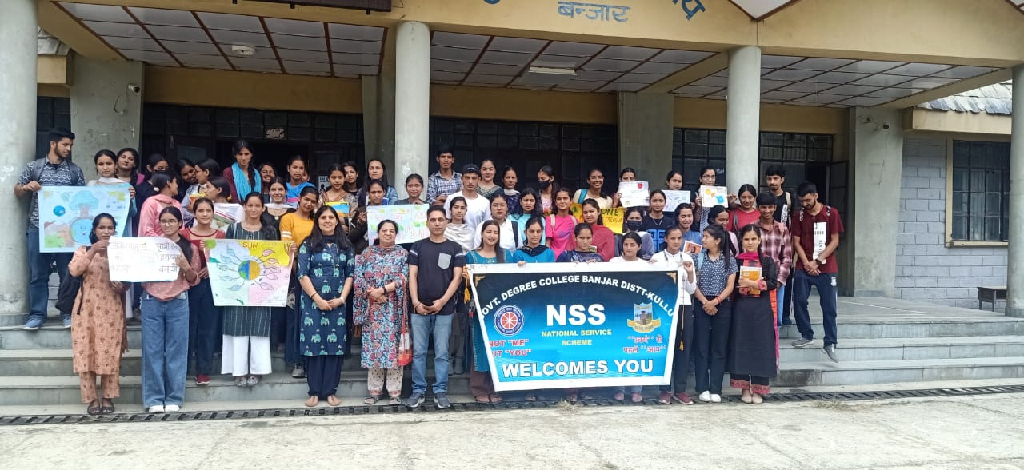
(VIII) Ozone Day Celebration by NSS unit :

Slide 35
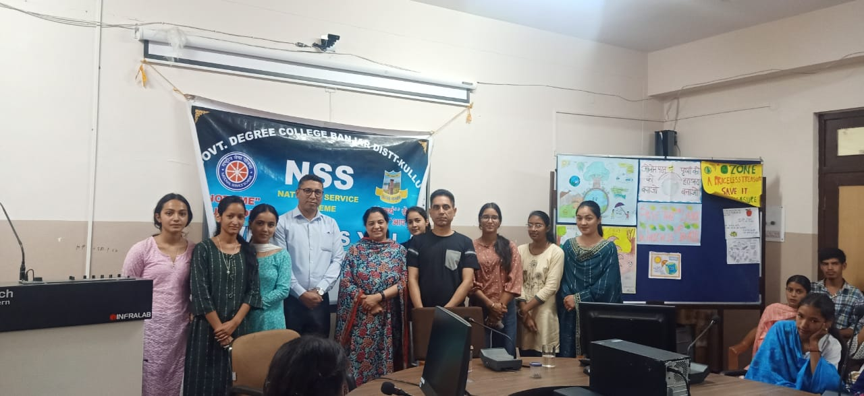

Slide 36
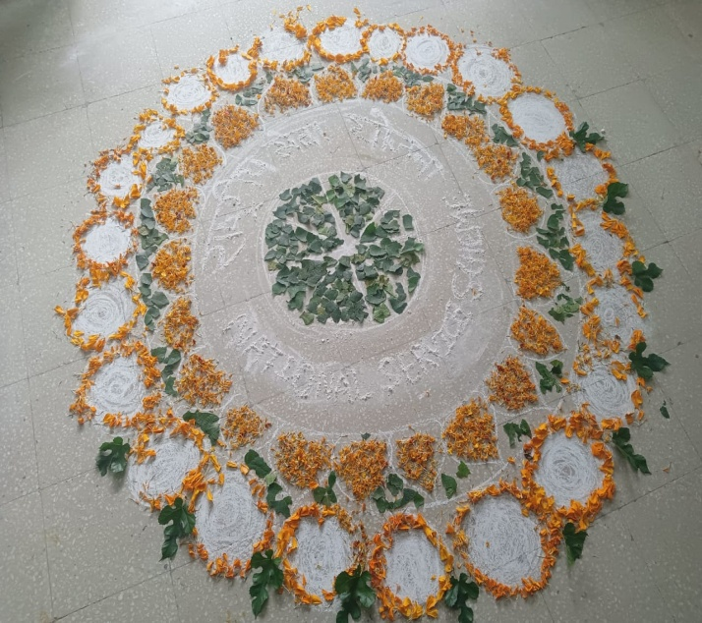
(IX) NSS Raising Day Celebration by NSS unit :

Slide 37
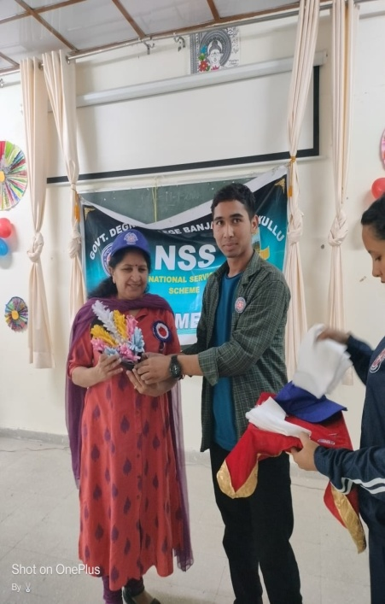
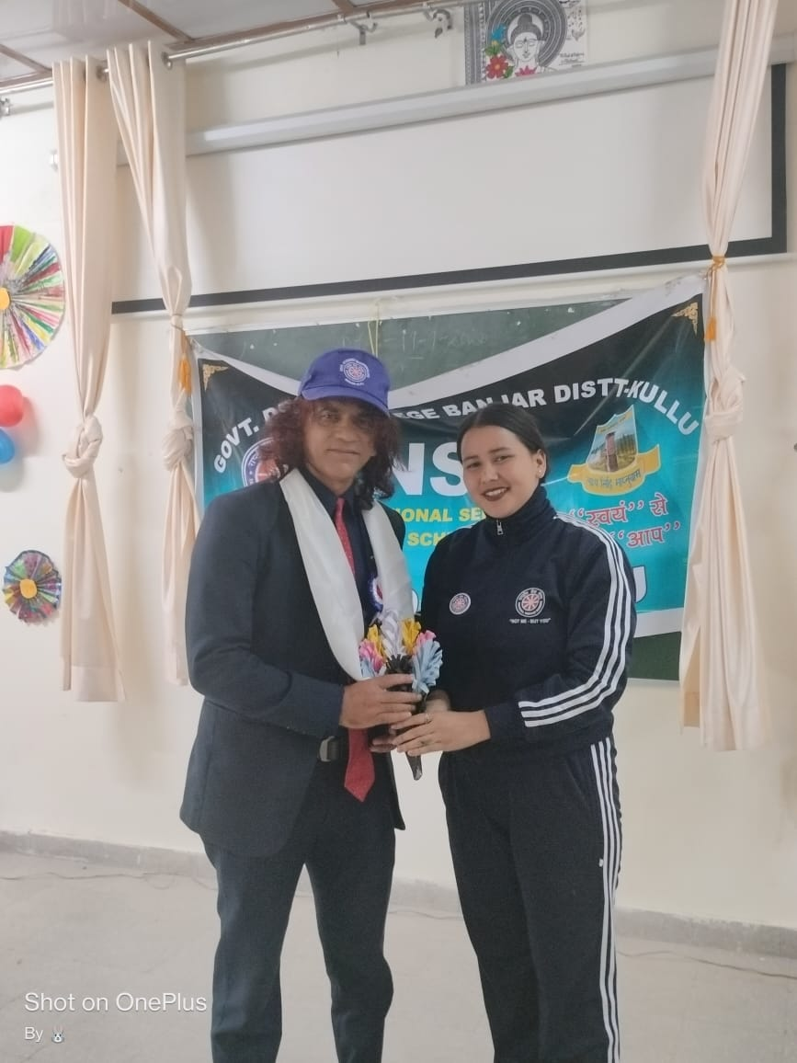
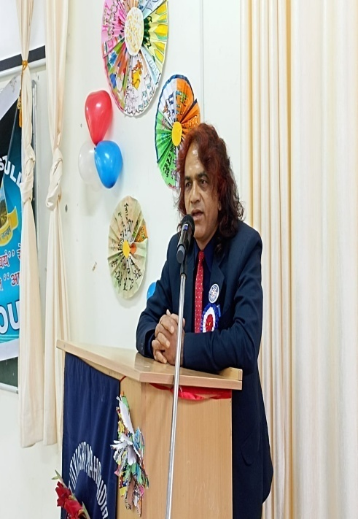

Slide 38
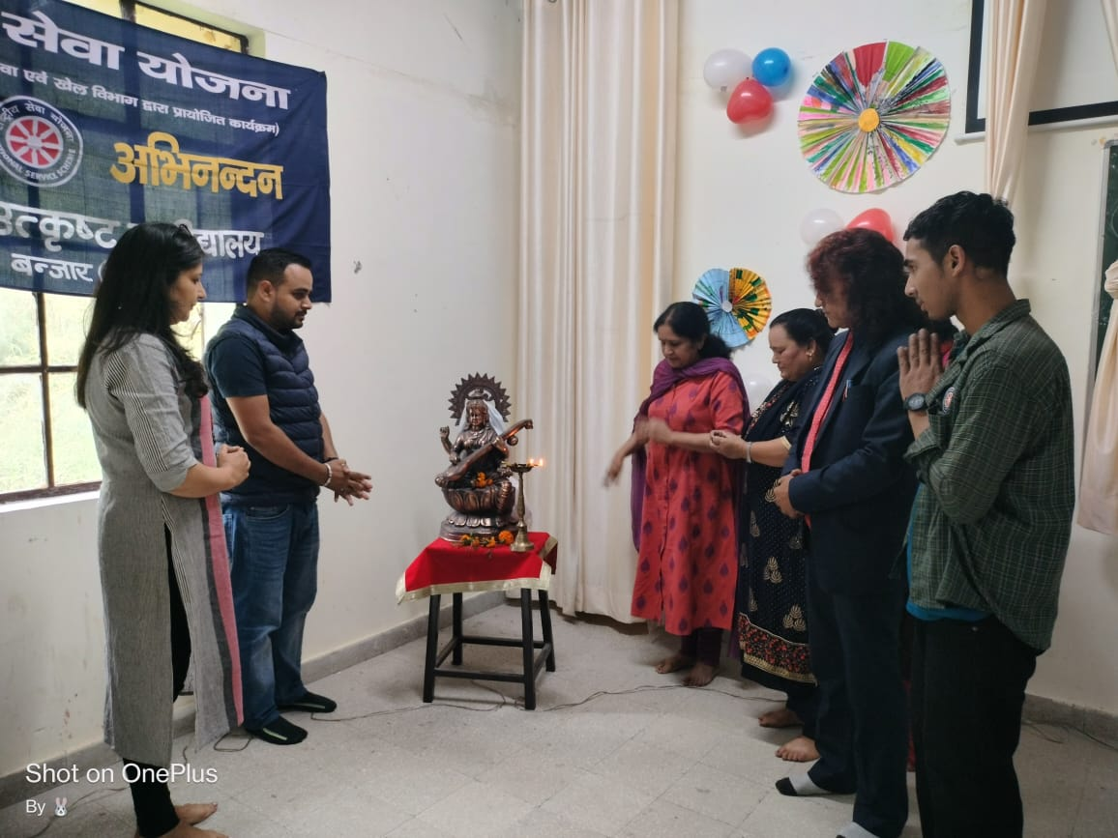

Slide 39
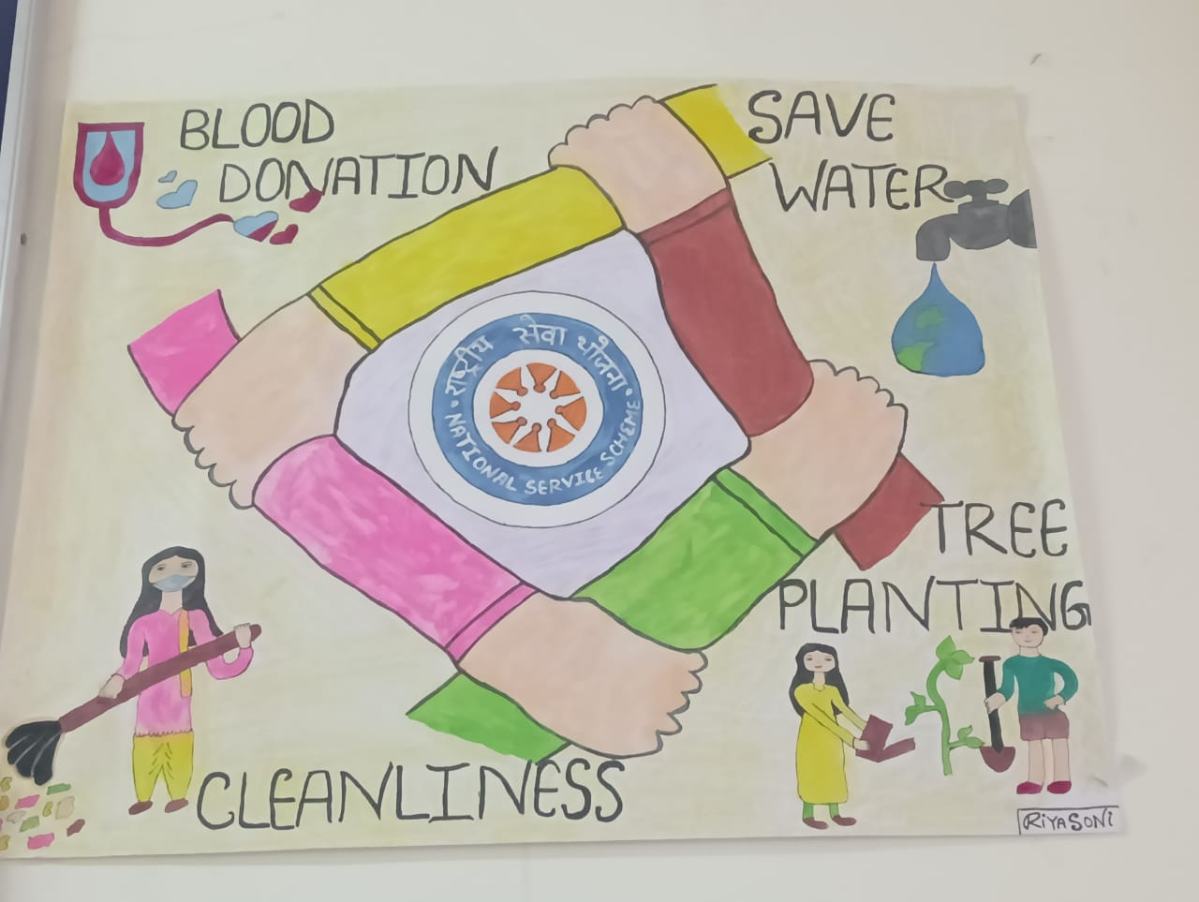

Slide 40
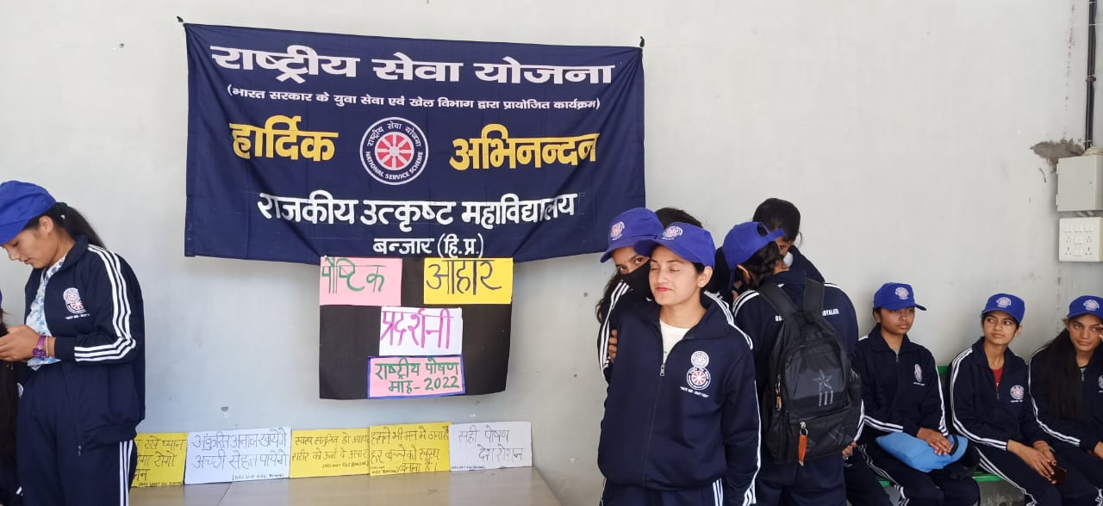
(X) Aahar Pradarshni during Poshan Mah by NSS Unit:

Slide 41
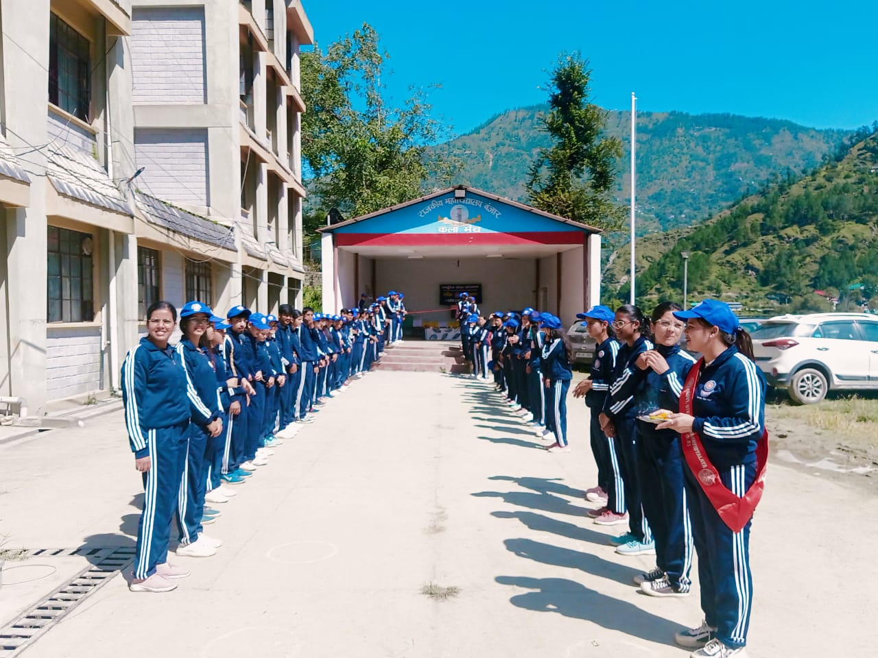

Slide 42
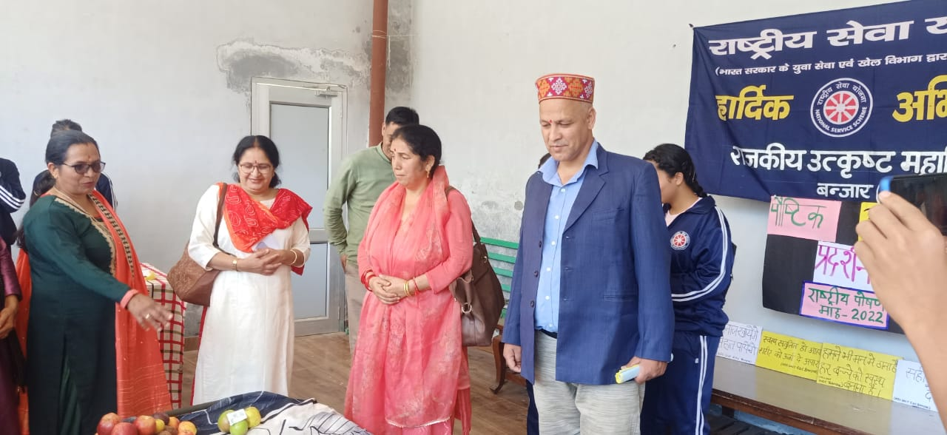
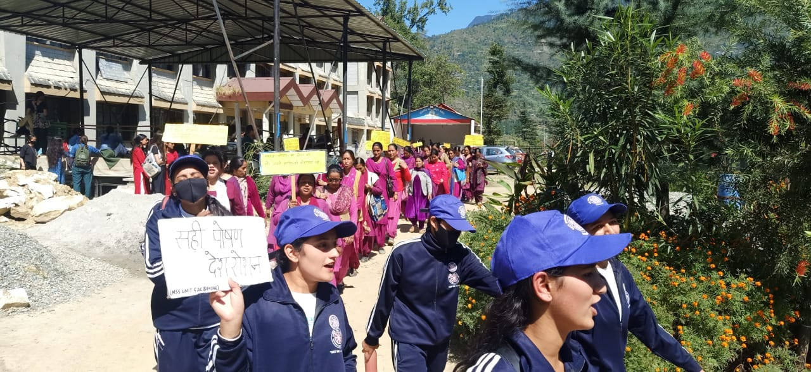

Slide 43
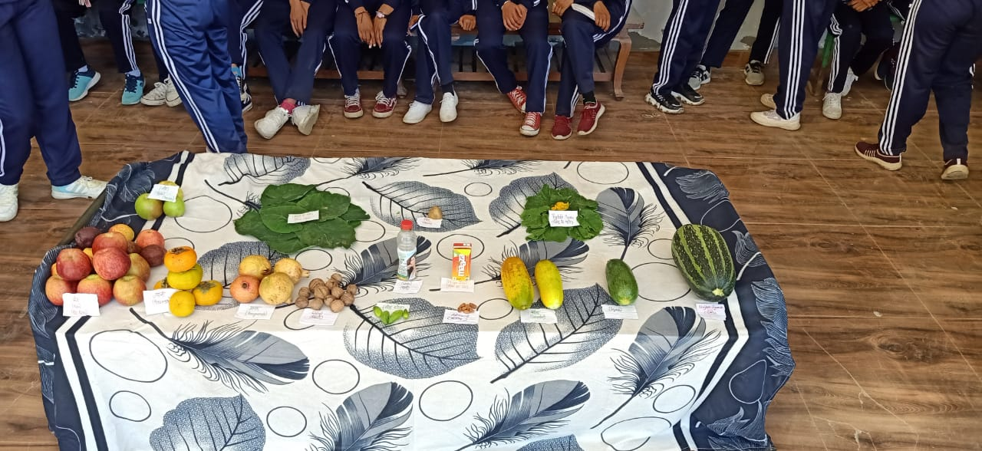

Slide 44
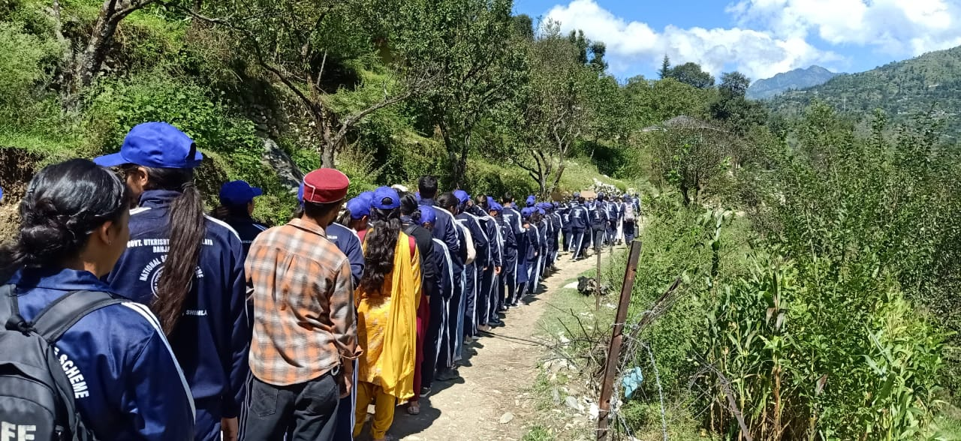
(XI) One day Cleanliness drive at Adopted Village Bala of Balagad Panchayat by NSS Unit:

Slide 45
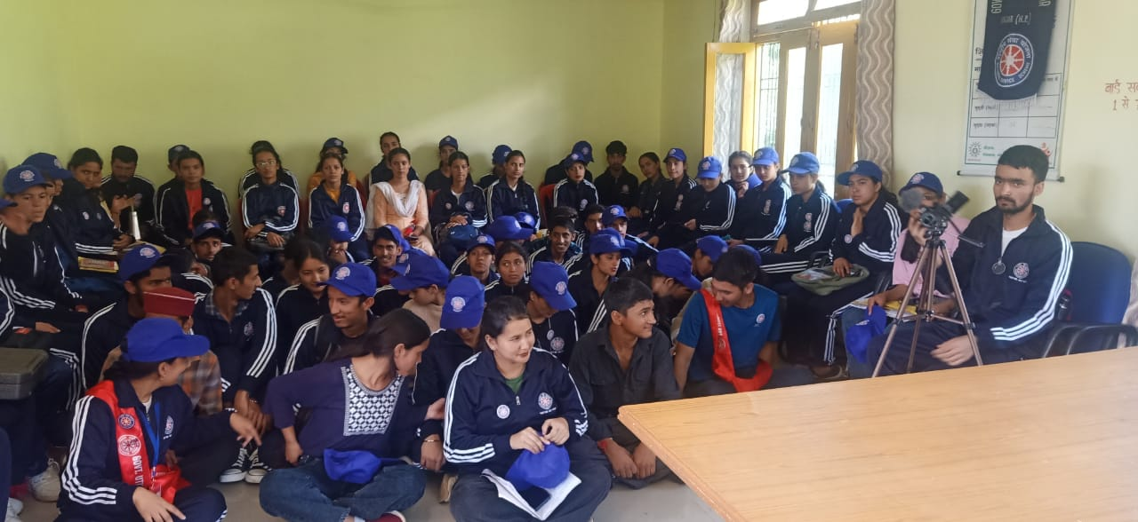

Slide 46
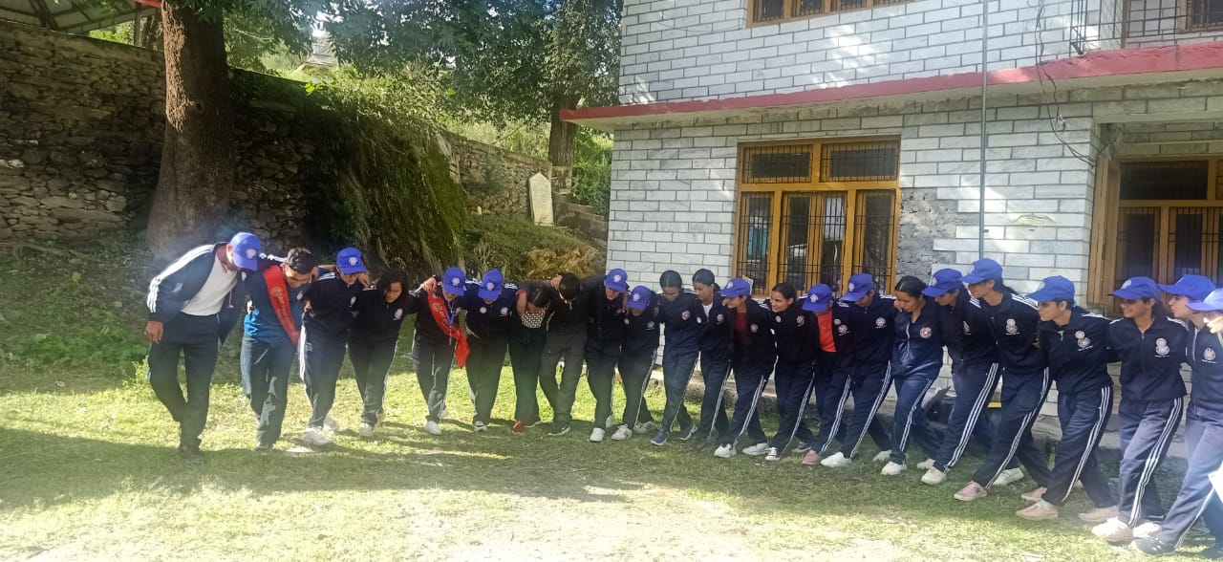

Slide 47
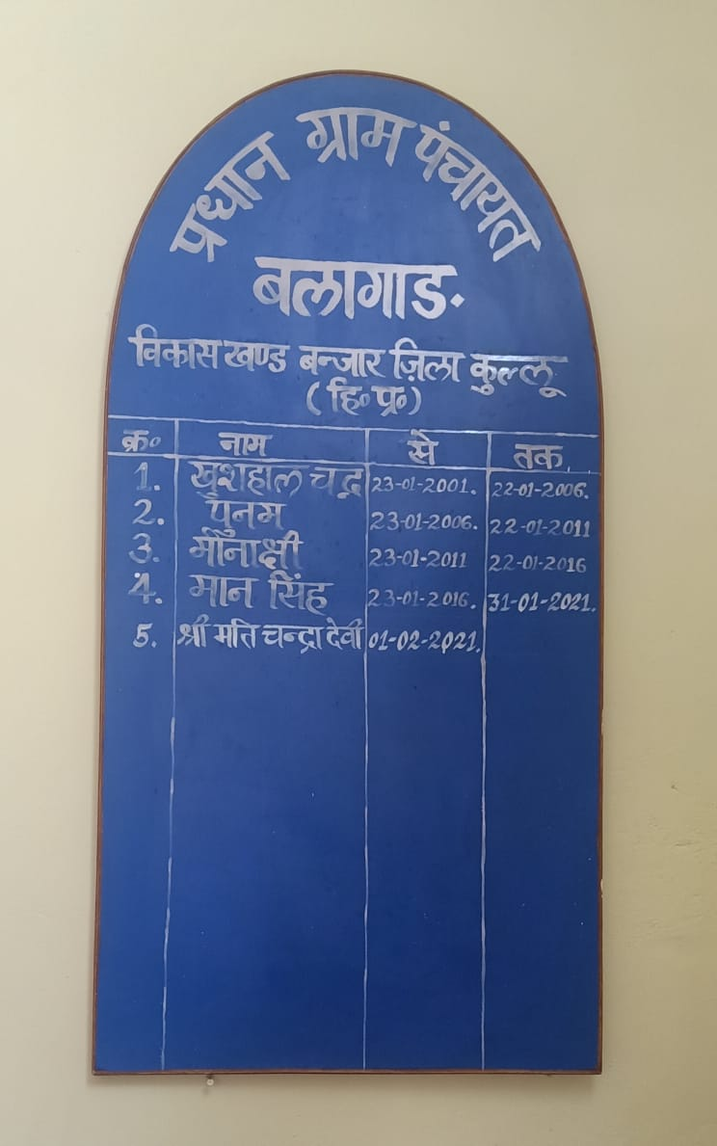
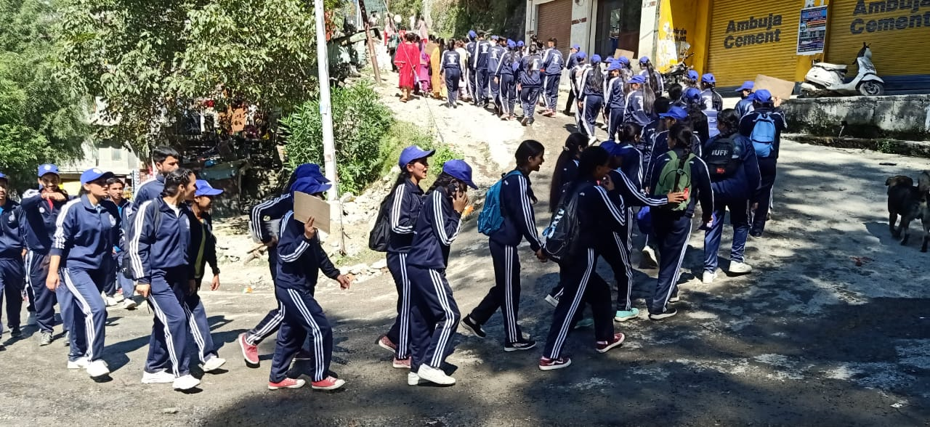

Slide 48
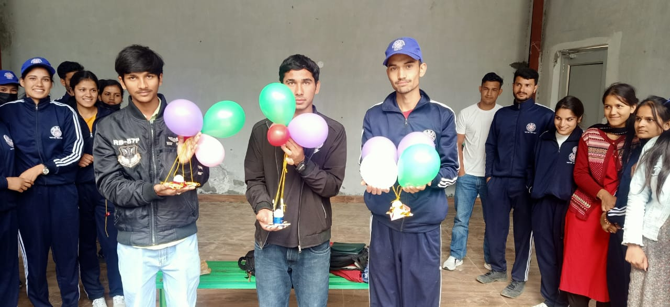
(XII) Personality Development Activities by NSS Unit:

Slide 49
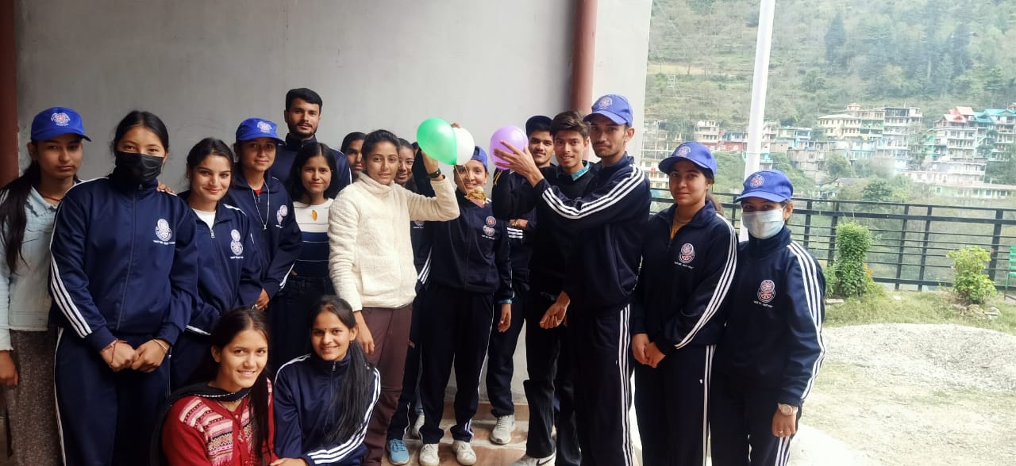
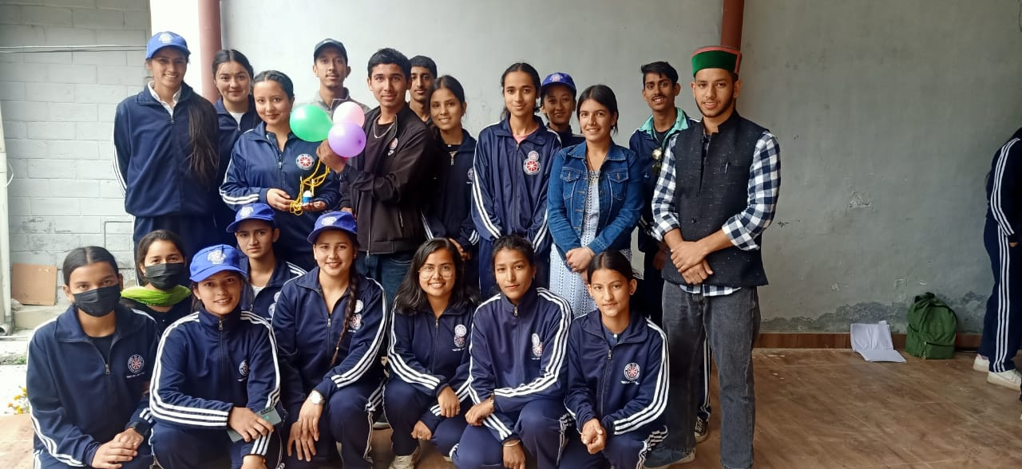

Slide 50
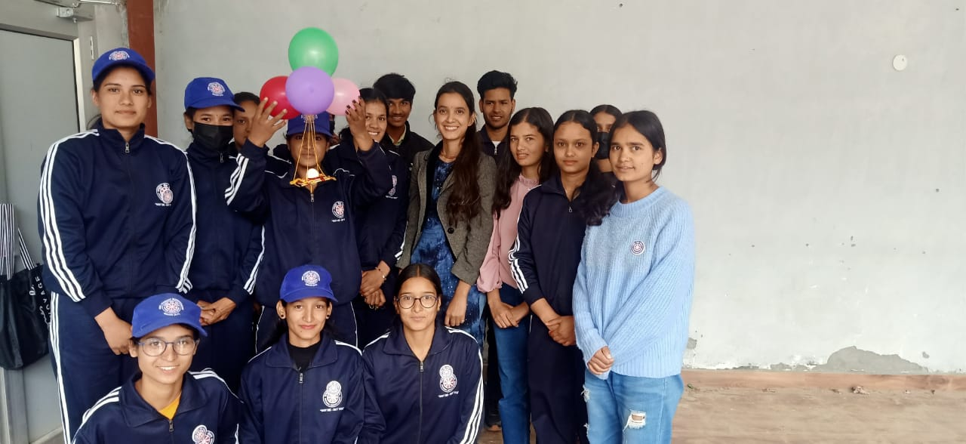

Slide 51
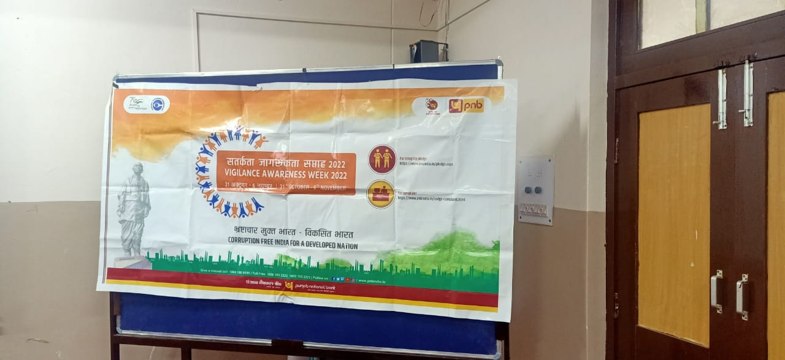
(XIII) Vigilance Awareness week by NSS Unit:

Slide 52
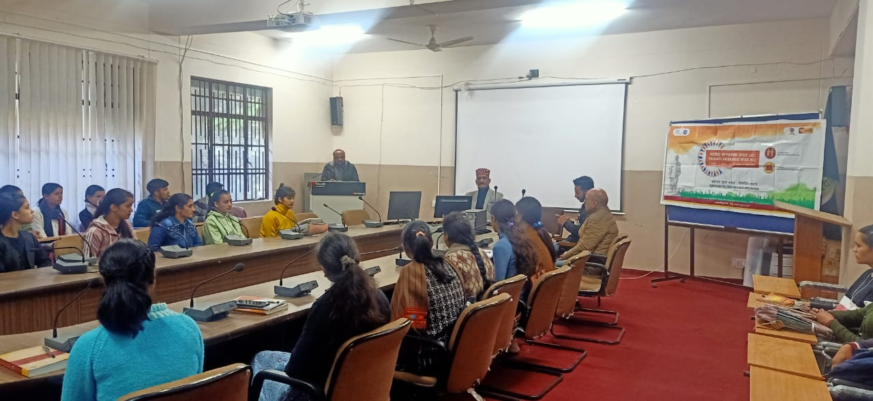

Slide 54
(XIV) Nasha Mukti Abhiyan by NSS Unit:

Slide 56
(XV) One Day Shramdan for Society by NSS Unit:

Slide 61
(XVI) National Constitution Day Celebration by NSS Unit:

Slide 66
(XVII) World AIDS Day Celebration by NSS Unit:

Slide 69
World AIDS Day-2022 Theme:
“Equalize” ßlekurkÞ

Slide 71
(XIII) International Volunteers Day Celebration by NSS Unit:

Slide 75
(XIX) World Human Rights Day Celebration by NSS Unit:

Slide 81
(XX) Participation by NSS Volunteers in 2022-23:
The 16 Volunteers of NSS unit were participated 4 Days National level training programme on Personality Development, Leadership, Gender Sensitization and Entrepreneurship Development at Rajiv Gandhi National Institute of Youth Development, Regional Centre Chandigarh-12.
Mr. Dheeraj Thakur, B.A.-IInd Year participated in State level Pre-Republic Day Parade Selection Camp held at JLN Govt. Degree College Haripur (Manali).
Ms. Omrita Sethi, B.Sc.-IIIrd Year Participated in North Zone Pre-Republic Day Parade Camp at Lovely Professional University Phagwara (Punjab) from 26th November, 2022 to 05th December, 2022.

Slide 82
Ms. Omrita Sethi

Slide 86
(XXI) Tools/ Equipments Purchased for NSS Volunteers :

Slide 89
(XXII) Fire Safety Awareness Drive by NSS Volunteers :

Slide 97
“Not Me-But You”
Thank You

